Slide 1
Andrei Kolmogorov
&
An application of the Probability Theory

Slide 2
Today, we would like to introduce Andrie
Kolmogorov, the founder of the probability theory and
one application of this theory. As you can see the
background of the slides, the application we are going
to talk about is a gambling game.

Slide 3
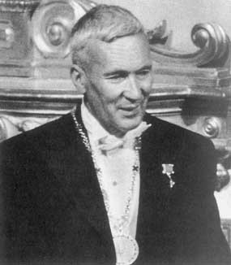
Andrei Nikolaevich Kolmogorov was born in Tambov, Russia, on April 25th 1903
He became one of the foremost Soviet mathematicians of the Twentieth Century
He was active in many mathematical fields
Kolmogorov wrote his first paper on probability in 1925, and the subject became one of his most productive areas.
His innovative work transformed the science of probability theory
His influence on the subject has been likened to that of Euclid on geometry.

Slide 4
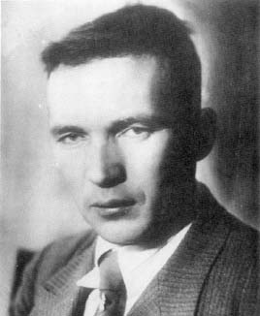
Interesting Events in Kolmogorov’s Life
Russian History was his passion during his teenage years, but he
eventually decided to study Mathematics. It is known that his
History teacher once told him that maybe in mathematics one proof
is considered to be sufficient, but in history it is preferable to have
at least ten profs.

Slide 5
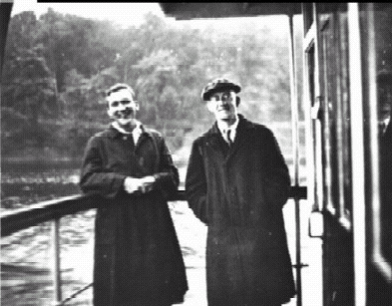
Kolmogorov and Aleksandrov’s Friendship
It was his friendship with Aleksandrov, another famous Russian
mathematician, that boosted Kolmogorov’s interest for probability.
In the summer of 1929, they went by boat on a trip down the Volga
across the Caucasus mountains to Armenia. During these three
weeks, they sunbathed, swam and did mathematics.

Slide 6
An application of the Probability Theory

Slide 7
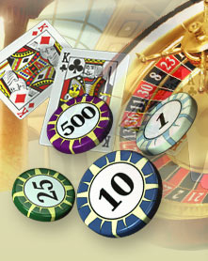
Maths can be applied to things more interesting than you think.
In fact, it is said that the whole area of Probability was invented primarily in an attempt to improve the chances of mathematicians betting on Roulette and card games in gambling halls some years ago.
Today, we’d like to discuss one of the card games-Blackjack to see how the theory of probability is applied to this game.
Blackjack is an easy game to learn how to play. We’ll assume you’ve never played before and go over the basics.

Slide 8
Before you sit down at a blackjack table,
glance at the sign that sits on the table because
it will tell you minimum amount you must bet per
hand. If you are a $5 per hand player than you
want to locate a table that allows $5 minimum
bets per hand.

Slide 9
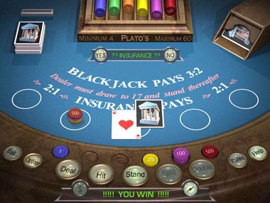
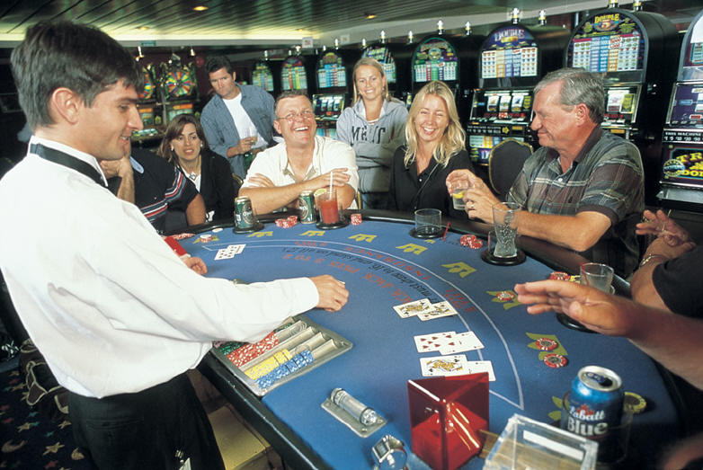

Slide 10
The Objective of Blackjack
Having a total that exceeds the dealer’s total
Not going over 21 when the dealer does
The highest hand in blackjack is an Ace and any
10-point card and is called blackjack.

Slide 11
All cards count their face value in blackjack.
Picture cards count as 10.
Ace can count as either a 1 or 11.
Card suits have no meaning in blackjack.
The total of any hand is the sum of the card values in the hand.
5
5
Q
Q
15

Slide 12
Every player and dealer will receive two cards.
One of the dealer’s card is dealt up so that players can see its value.
The two player cards can be either dealt face up, face down, or sometimes one up and one down depending on the rules.
After the player looks at his initial two cards and sees the value of one of the dealer’s two cards, the player must make a playing decision. This includes the following:

Slide 13
Hit
This means you want the dealer to give you another card to your hand.
2) Standing
This means you are satisfied with the total of the hand and want to stand with the cards you have.
3) Pair Splitting
If you have two like cards (e.g. a pair of 6’s), you could exercise the option to split. When you split you must make another bet equal to your original bet. By pair splitting, you play each card as a separate hand and you can draw as many cards as you like to each hand.

Slide 14
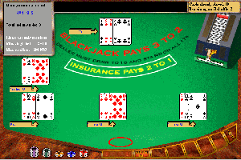
4) Doubling down
You can double your bet in return for receiving one
and only one draw card.
5) Surrender
It allows a player to forfeit the hand with an automatic
loss of half the original bet.

Slide 15
Unlike players, the dealer in blackjack has no playing option.
Casino rules specify that a dealer must draw when the dealer’s hand totals less than 17 and stand when the total is 17 to 21.
If the player’s hand exceeds a total of 21, the player automatically losses.
If the player’s hand exceeds the total of the dealer’s hand, the player wins the hand and is paid at 1:1 odds.
If the player and dealer have the same total, the hand is tie or push and the player retains his bet.

Slide 16
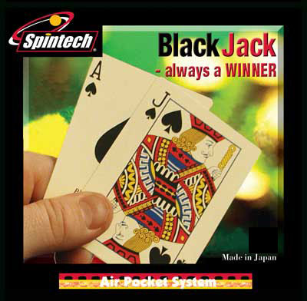
How does the theory of probability apply to this game?

Slide 17
Blackjack is one of the best games you can play in a casino because of the low house edge.
Mathematicians and blackjack experts have used computer simulations and statistical analyses to try to find a way to beat the house at blackjack.
Today, we’d like to discuss why single deck games are better.

Slide 18
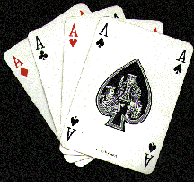
Suppose you took a single deck of cards, shuffled them, and then randomly picked one card.
What is the probability that you’ll pick an Ace?
The probability is
4
52

Slide 19
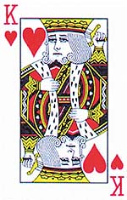
Once you draw the Ace, you are left with 51 cards to draw a ten-value card. There are 16 ten-value cards in a deck of cards (the four tens, jacks, queens and kings).
What is the probability that you’ll pick a Ten-Value card?
10
The probability is
16
51
10

Slide 20
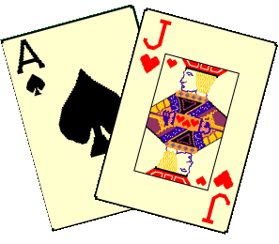
What is the probability of getting an Ace followed by a ten-value card in a single deck?
As we learned, we should multiply two probabilities for the conditional events.
So, we get
4 16
52 51
X
2.415%

Slide 21
However, you could have just drawn the ten-value card first then the ace.
The overall probability of getting a blackjack hand in a single deck game is twice 2.415 or 4.82%.
For a 6-deck game the chance of drawing the ace as the first card is the ratio 24 over 312.
The chance of drawing the ten-value as the second card is the ratio 96 over 311. Multiply the two ratios and you get 2.37%. Double it and you get 4.74%.
4.74% is less than 4.82% probability of getting a blackjack in a single deck game.

Slide 22
These probabilities can be translated into important statistics in blackjack.
For example, 4.82% translates into one blackjack out of every 20.72 hands.
The following chart is the result of getting a blackjack hand in different deck games:
Single 1 in every 20.72 hands
Double 1 in every 20.93 hands
Four 1 in every 21.02 hands
Six 1 in every 21.07 hands
Eight 1 in every 21.07 hands
Notice that you’ll only be 98% as successful at drawing a blackjack in an eight-deck game compared to a single deck game, which makes the single deck game better.

Slide 23
The second reason why the single deck game is better than a multiple game is that the dealer chances of duplicating a blackjack is less in a single deck game.
The exact probabilities of dealer duplicating our blackjack in the same round are:
Single 1 in every 27.25 hands
Double 1 in every 23.74 hands
Four 1 in every 22.34 hands
Six 1 in every 21.92 hands
Eight 1 in every 21.71 hands
Notice that blackjack pushes are about 20% more likely in a six or eight deck game compared to a single deck game.

Slide 24

Another reason that a player’s expectation is better
in a single deck game is that he is more likely to get a
good hit when doubling down on 10 or 11 compared to
the same situation in a multiple deck game.

Slide 25
To summarize the major reasons why single deck game is better than a multiple deck game is:
You will be dealt more blackjack hands;
The dealer is less likely to also have a blackjack hand and tie you;
You are more likely to draw a good card when you double down on 10 or 11.

Slide 26
Conclusion
Although the probability theory can be applied to
many gambling games, we don’t advice you to play
any. We used to compute the expected value of
loosing games in casino, remember? Maybe, you will
win occasionally, but the more you addict to these
games, the less probability you can beat the casino.

